Slide 1

Shasta and Lassen Counties: Facing Dire Health Care Access Challenges with Creativity and Resilience

Slide 2
Shasta and Lassen Counties: Facing Dire Health Care Access Challenges with Creativity and Resilience
Jill Yegian, PhD
Yegian Health Insights
April 2, 2026

Slide 3
Agenda
01 | Welcome and Project Overview — Sandra Hernández, MD
02 | Summary of Study Findings — Jill Yegian, PhD
03 | Panel Discussion with Regional Experts Wendi Davis, MHA, COO, Partnership Health Plan Shannon Gerig, RN, CEO, Mountain Valleys Health Centers G. Todd Smith, President, Mercy Medical Center Redding J. Brandon Thornock, MBA, MHA, CEO, Shasta Community Health Center Kristof Stremikis, MPP, MPH, Director, Market Analysis & Insight, CHCF
04 | Audience Q&A

Slide 4
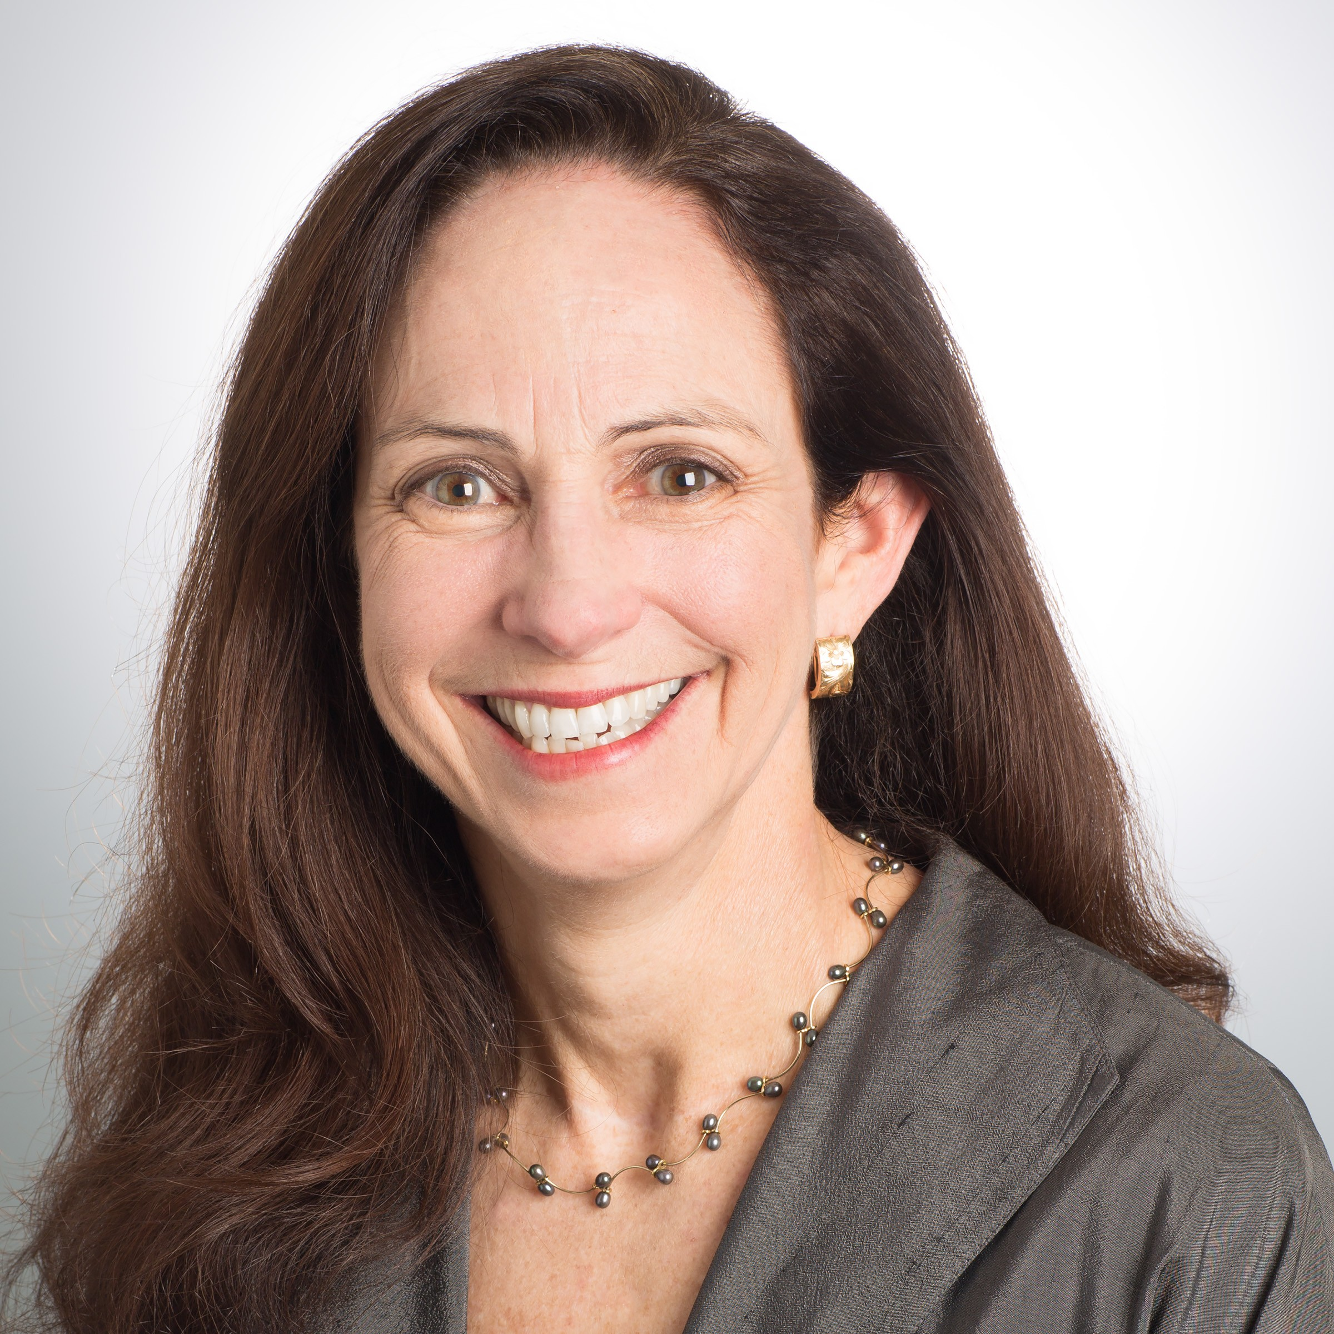
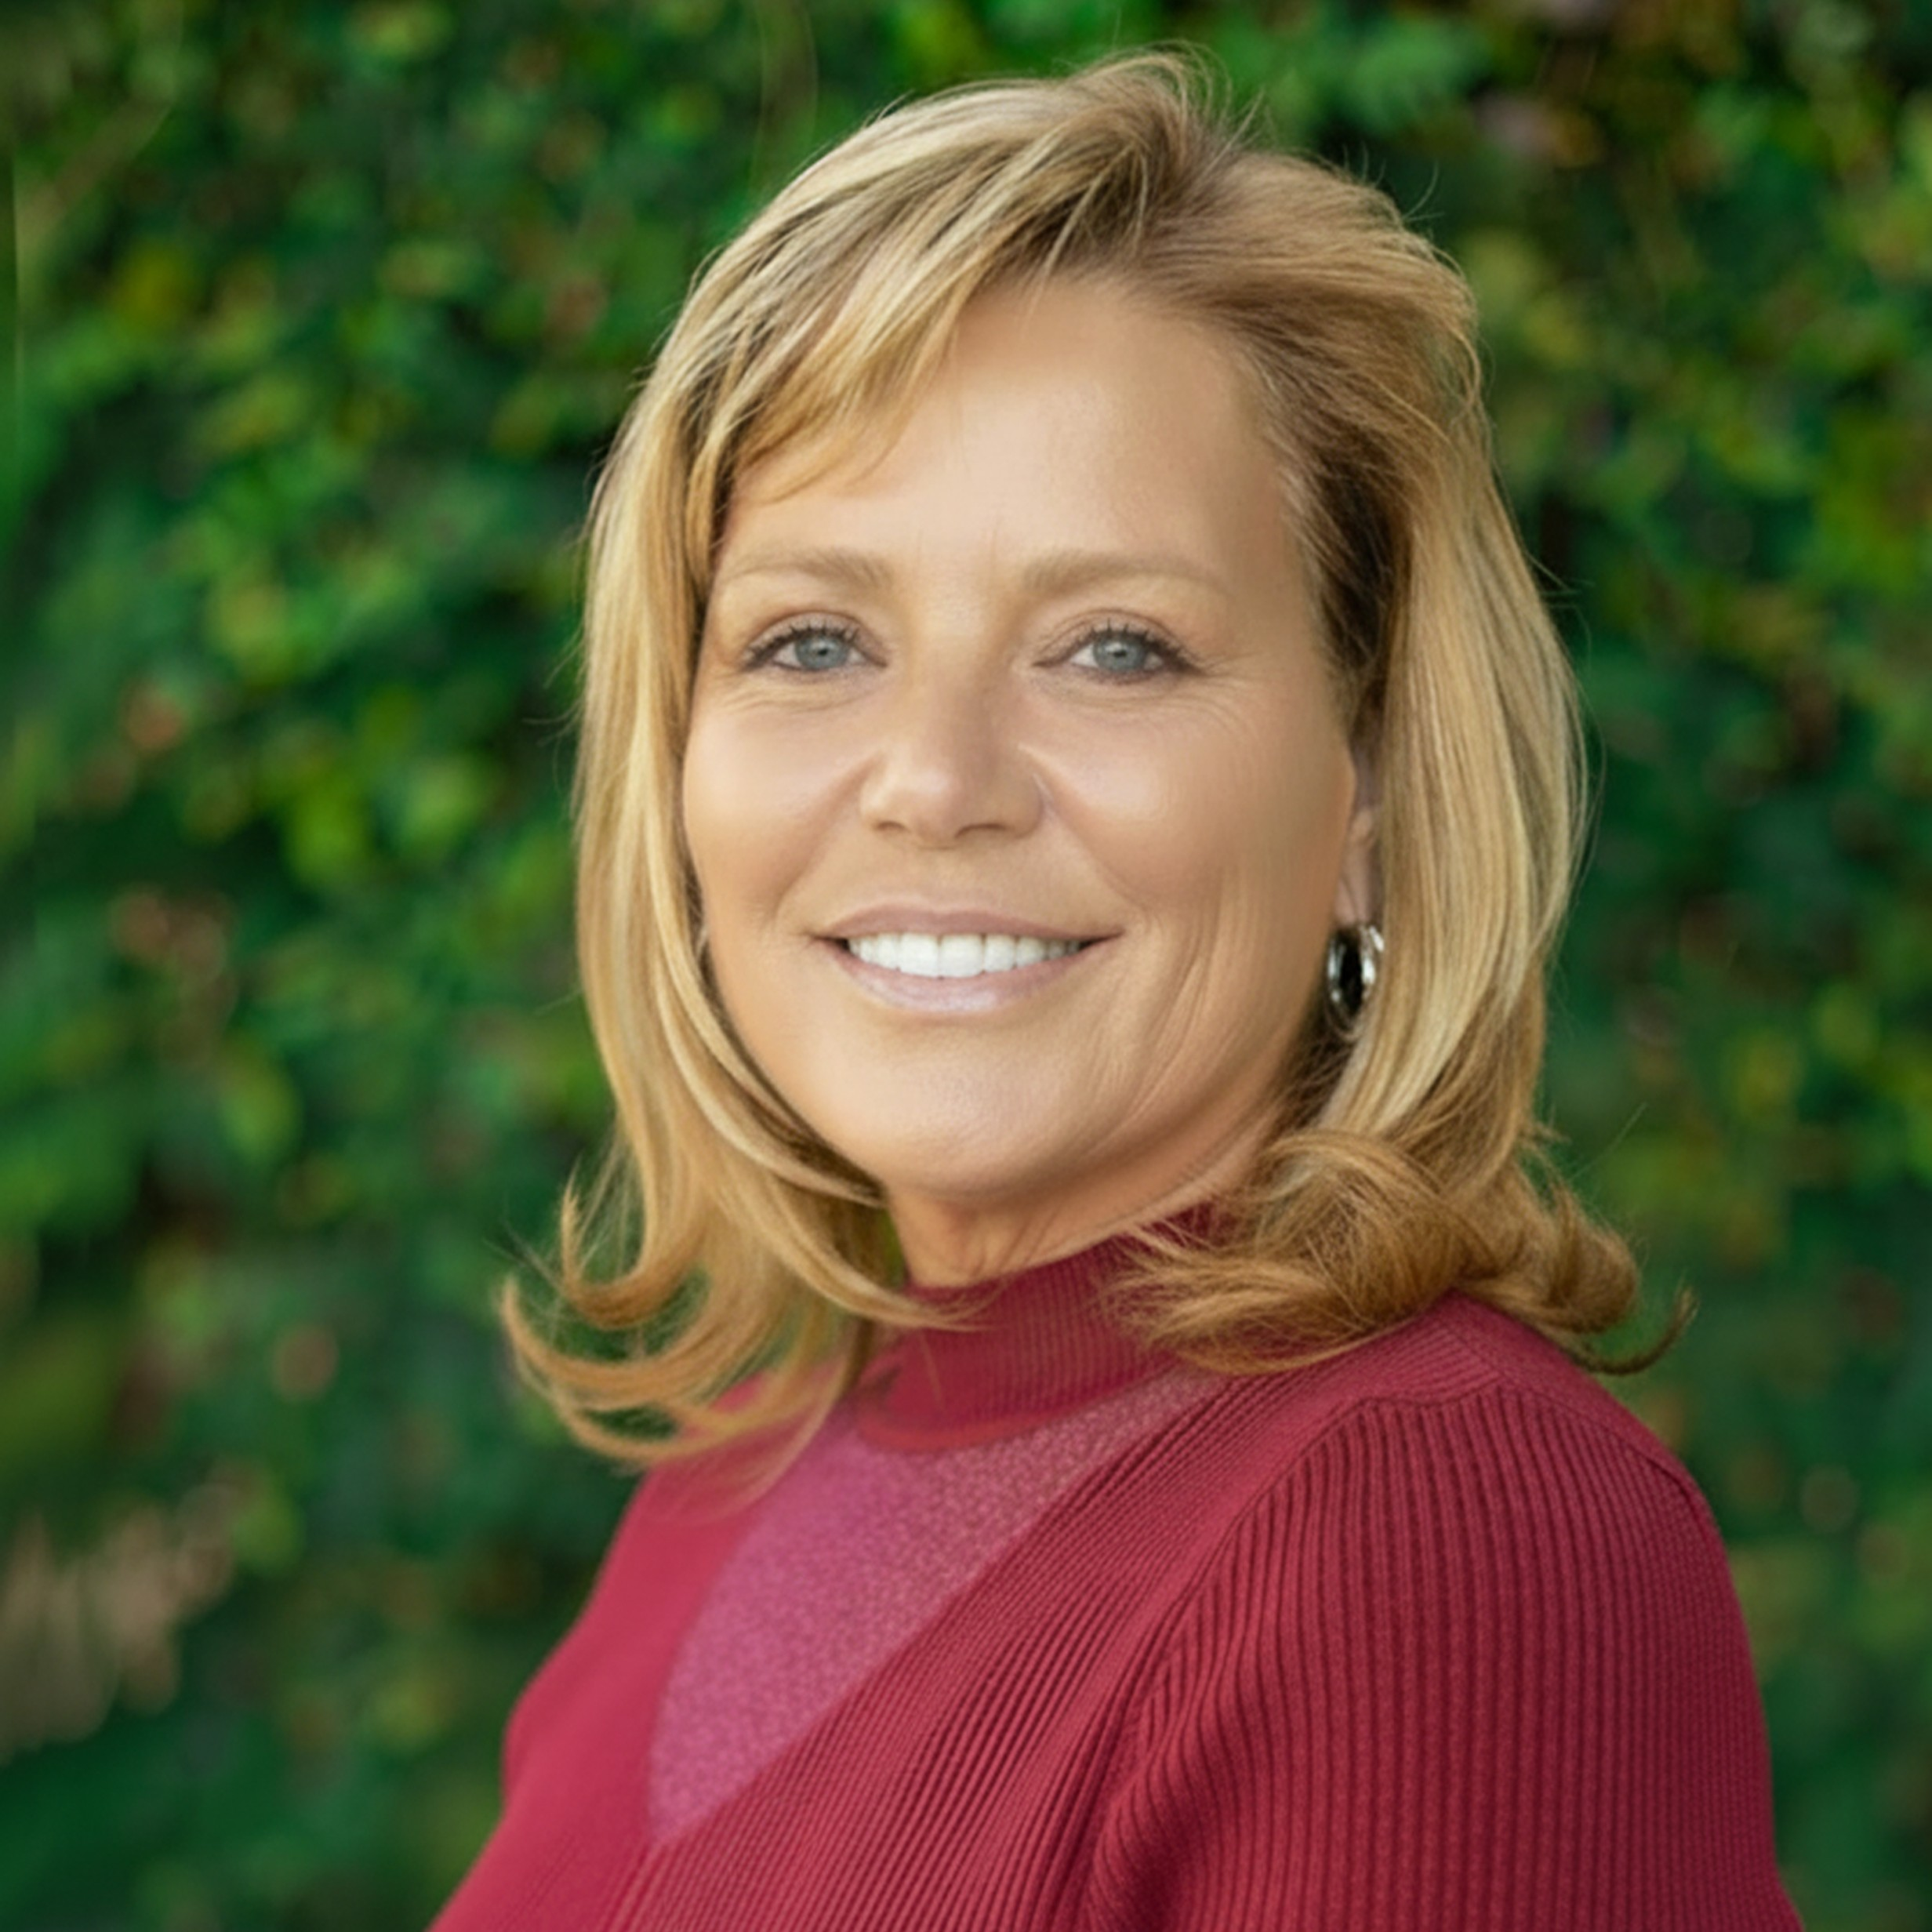

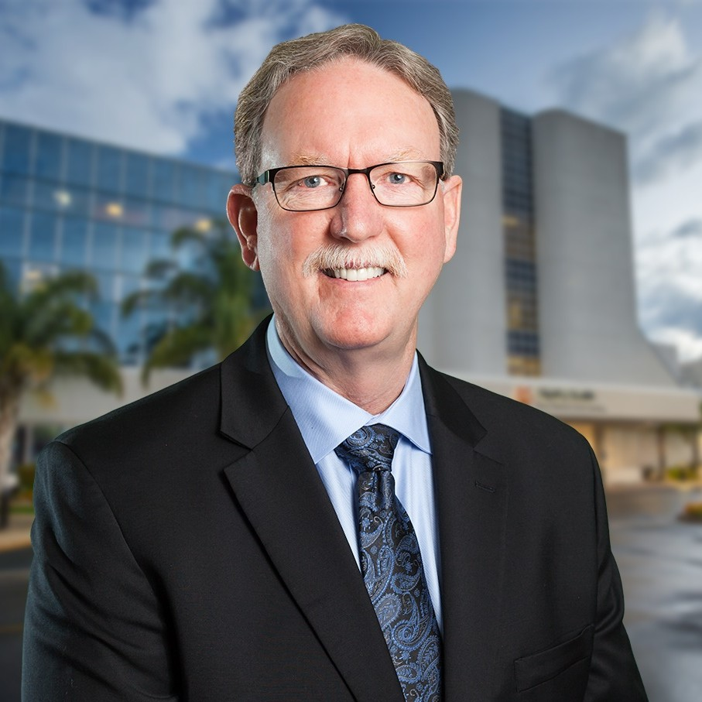
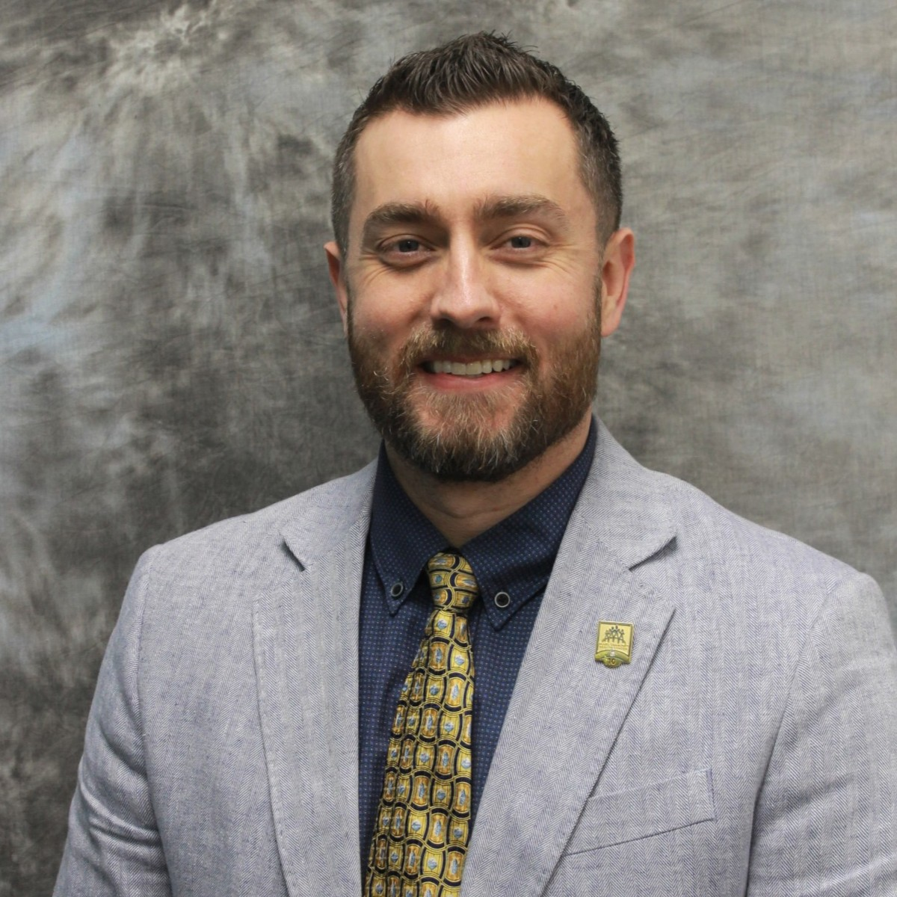
Panelists
Jill Yegian, PhD
Project Director and Regional Lead, Yegian Health Insights
Wendi Davis, MHA
COO, Partnership Health Plan
Shannon Gerig, RN
CEO, Mountain Valleys Health Centers
G. Todd Smith, MBA
President, Mercy Medical Center Redding
J. Brandon Thornock, MBA, MHA
CEO, Shasta Community Health Center
Views expressed by panelists are their own and do not necessarily reflect those of CHCF.

Slide 5
Project Overview
The purpose of the study is to gain key insights into the organization, financing, and delivery of care in communities across California and over time. This is the fifth round of the study; the first set of regional reports was released in 2009.
The markets in the 2025 study are Inland Empire, Los Angeles, Sacramento, San Diego/Imperial, San Francisco Bay Area, San Joaquin Valley, and Shasta/Lassen.
The Yegian Health Insights consulting team includes Jill Yegian, Ted Calvert, Caroline Davis, Len Finocchio, Marian Mulkey, Katy Wilson, Alwyn Cassil, Karen Shore, and Jessica McLaughlin.
Seven reports, each along with a webinar or in-person event, will be released in 2026.

Slide 6
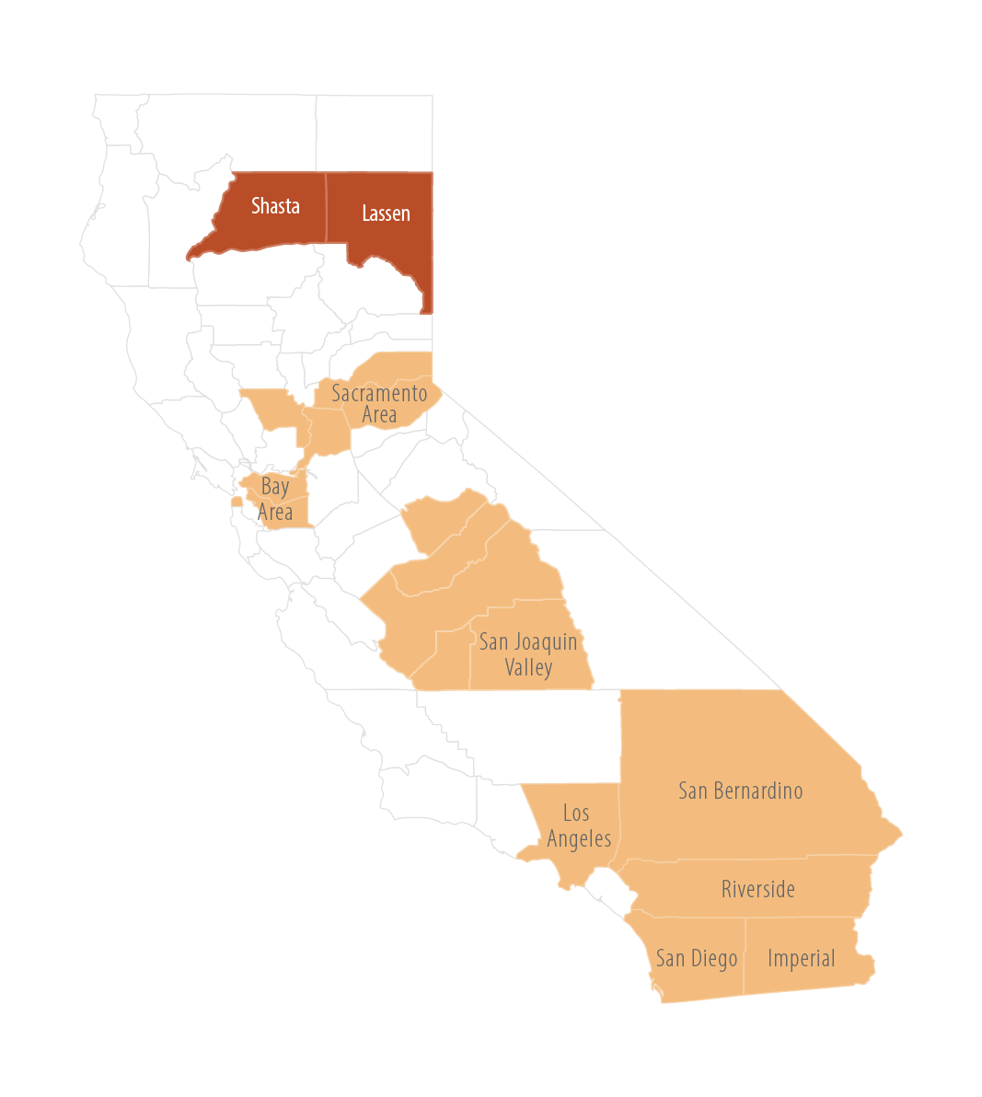
Approach and Information Sources
Quantitative data from many sources, including the California Department of Health Care Access and Information (HCAI), US Census, California Health Interview Survey, and others
News stories, industry reports, journal articles, policy analyses, government meeting proceedings
Qualitative data generated by interviews with 28 regional leaders, including:
Medi-Cal managed care plan (Partnership)
Hospitals, community health centers (CHCs)
County government
Regional experts
Interviews conducted between March and June 2025 (before passage of HR 1)
Qualitative data generated by interviews with 15 statewide leaders
San Joaquin Valley

Slide 7
Shasta and Lassen Population Overview
2023 data unless otherwise noted
Shasta and Lassen Counties:
Home to 210,000 people (2024)
Declining population
Almost half (~93,000) live in Redding
Much of the two counties is rural
* 2024 data
For data sources and more detail, see Table 1 in Shasta and Lassen Counties: Facing Dire Health Care Access Challenges with Creativity and Resilience (PDF).
Notes:
Compared to California overall:
Higher poverty and unemployment but more likely to afford median home (2024)
Older
Less likely to be college+ educated
Much greater share of residents are White, much smaller share is Latino/x
Larger American Indian population

Slide 8
High Mortality Rates and “Deaths of Despair”
Age-Adjusted Death Rates per 100,000 Population, by Cause, 2021–23 | Shasta | Lassen | California
All causes | 996.4 | 832.9 | 634.1
All cancers | 163.7 | 115.1 | 118.7
Coronary heart disease | 99.4 | 95.9 | 72.2
Accidents (unintentional injuries) | 83.4 | 88.1 | 49.8
Chronic liver disease and cirrhosis | 25.4 | * | 14.4
Firearm-related deaths | 15.5 | * | 8.4
Motor vehicle crashes | 15.1 | 20.3 | 11.6
Suicide deaths (2020–22) | 28.2 |  | 10.1
Drug-related overdose deaths (2023) | 49.0 |  | 29.1
* Unreliable due to high standard error
For data sources and more detail, see Tables 3 and 4 in Shasta and Lassen Counties: Facing Dire Health Care Access Challenges with Creativity and Resilience (PDF).
Notes:
Compared to the state, Shasta and Lassen have:
A suicide rate almost 3x higher
Much higher rates of drug-related emergency department (ED) visits and deaths
Higher infant mortality rates
Greater prevalence of high blood pressure, anxiety, and depression
Much higher age-adjusted mortality rates, notably for cancer, heart disease, accidents, and respiratory disease

Slide 9
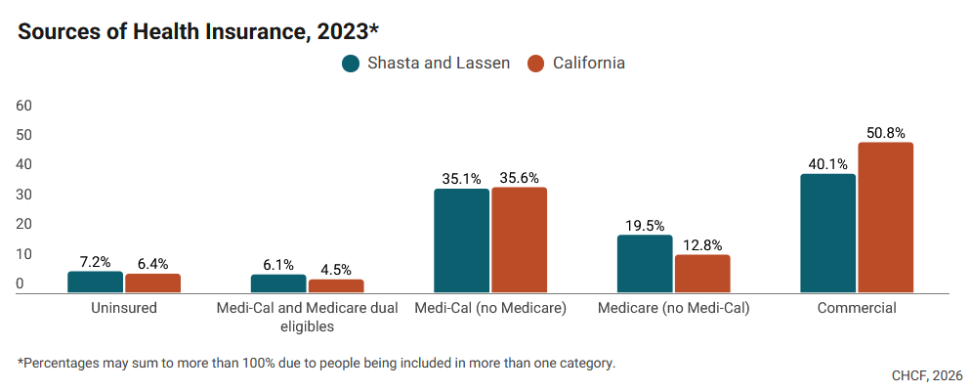
Higher Medicare, Lower Commercial Coverage vs. State
For data sources and more detail, see Table 5 in Shasta and Lassen Counties: Facing Dire Health Care Access Challenges with Creativity and Resilience (PDF).

Slide 10
Partnership Health Plan, Sole Medi-Cal Plan, Well-Regarded in Region
Almost 40% of Shasta and Lassen residents had Medi-Cal coverage in 2024.
Partnership Health Plan serves all 76,000+ of those Medi-Cal members in Shasta and Lassen and has provided Medi-Cal coverage in the area since 2013.
Shasta and Lassen are two of 24 counties Partnership serves throughout northern California, after adding 10 new counties in 2024 and increasing enrollment to 900,000 overall.
Partnership is known for strong quality improvement programs and its presence in local communities across the region.
“They have been amazing to work with. They are beholden to all the DHCS rules and regulations, but they care about our population.” —Interview participant

Slide 11
Financial Health of Area Hospitals Varies Widely
Hospital (System), 2023 Data | Available Beds | Net Income Margin* | Share of Discharges in Region | % Medi-Cal (Discharges) | % Medicare (Discharges)
Mercy Medical Center Redding (Dignity / Common Spirit) | 266 | 12% | 65% | 29% | 48%
Shasta Regional Medical Center (Prime) | 226 | -5% | 30% | 23% | 59%
Mayers Memorial Hospital — Critical Access Hospital | 16 acute, 99 long-term care | 9% | 2% | 23% | 68%
Banner Lassen Medical Center (Banner) — Critical Access Hospital | 25 | -12% | 4% | 26% | 45%
Shasta and Lassen | 632 | 8% | 100% | 27% | 51%
California | 77,339 | 4% | n/a | 31% | 42%
* Net income margin is net income divided by the sum of net patient revenue, other operating revenue, and nonoperating revenue.
For data sources and more detail, see Table 11 in Shasta and Lassen Counties: Facing Dire Health Care Access Challenges with Creativity and Resilience (PDF).

Slide 12
Community Health Centers Care for Whole Community
“We serve the community — everyone in the community. There are no other providers. We are a very important community resource — one of the only resources the community has.”
—Interview participant
CHCs are often the main — and sometimes the only — care providers in rural and frontier communities.
To serve those with commercial and Medicare coverage, CHCs:
Contract with health plans
Figure out billing and reporting
Join Medicare accountable care organizations (ACOs)
For data sources and more detail, see Table 12 in Shasta and Lassen Counties: Facing Dire Health Care Access Challenges with Creativity and Resilience (PDF).
Notes:
Data show that CHCs in Shasta/Lassen have:
More patients and encounters than statewide
Fewer patients below the poverty line
A smaller share of net patient revenue from Medi-Cal

Slide 13
Severe Health Care Workforce Shortage Limits Access to Care
Physician supply, both primary care and specialist, is far below statewide average
Supply of nurses and advanced practice providers is higher than statewide average
Physicians in independent practice have declined significantly in recent years
Access to care is a serious and growing challenge
2024 Data | Shasta and Lassen (% of Statewide Average) | California
LICENSED PROVIDERS PER 100,000 POPULATION
Physicians | 236 (66%) | 358
Advanced practice providers | 151 (117%) | 128
Nurses | 1,672 (124%) | 1,353
Behavioral health providers | 342 (89%) | 384
PHYSICIAN DETAIL BY SPECIALTY AND HOURS WORKED
Physicians per 100,000 population
Physicians working 20+ hours/ week | 196 (67%) | 294
- Primary care | 87 (74%) | 118
- Specialty | 108 (62%) | 176
- Psychiatry | 7 (39%) | 18
“The most underserved populations are not the ones we think of — they are the commercial patients and our Medicare patients that don’t have a place to land because practices are so full.”
—Interview participant
For data sources and more detail, see Table 14 in Shasta and Lassen Counties: Facing Dire Health Care Access Challenges with Creativity and Resilience (PDF).

Slide 14
Many Efforts to Address Workforce Shortage
Training programs
Several residency programs in family medicine and internal medicine that build local supply.
Shasta Community Health Center offers a two-year paid fellowship program for nurse practitioners and physician assistants to support transition to full-time clinical roles.
Financial investments and incentives
Partnership Health Plan pays a bonus to primary care providers (physicians and advanced practice providers) who stay in the area after completing training.
Provider organizations affiliated with health systems rely on centralized resources for recruiting support.
Resources for loan repayment, housing, and other forms of compensation are identified.
Creative recruitment sources and tactics
CHCs are tapping into a program allowing licensed physicians from Mexico to practice in the US for three years.
Leaders personally cultivate locals who moved away for education.
Recruitment focus on nonmonetary appeal, such as mission, work-life balance (through availability of team-based care, integrated behavioral health, AI scribes), culture.

Slide 15
CalAIM Rollout Brings New Resources, and Complexity
Partnership has created a robust CalAIM team that conducts extensive outreach to increase awareness of the new benefits and opportunities.
About 2.6% of Medi-Cal members received Enhanced Care Management (ECM) services in Shasta/Lassen, 1.5% statewide
About 1.7% of Medi-Cal members received Community Supports (CS) services in Shasta/Lassen, 1.9% statewide
In Q4 2024, the most-utilized Community Supports services in Shasta and Lassen were:
Housing Transition Navigation (615 members)
Short-Term Posthospitalization Housing (413 members)
Medically Tailored Meals (301 members)
Respondents reported that CalAIM enabled expansion of services and staffing but came with challenging billing and reporting requirements.
Illustrative impact: CS funding enabled the HOPE Medical Respite Program to expand.
The program provides short-term residential care to people discharged from the hospital with unstable housing and who need a safe place to heal.
Shasta Community Health Center provides medical care and case management, and Pathways to Housing provides housing and hospitality services (meals, laundry).
“Connecting patients to resources, it feels like we’re making a difference.”
—Interview participant

Slide 16
Community Collaboration to Build Behavioral Health Infrastructure Denied State Funding
Inpatient behavioral health services are scarce in Shasta and nonexistent in Lassen, and patients often must wait in the ED for placement.
CHCs and tribal systems have ramped up to fill gaps, and telemedicine is widely used — but a severe shortage persists.
Led by Arch Collaborative and supported by Shasta Health Assessment and Redesign Collaborative (SHARC), a long-standing multistakeholder group, community organizations in Shasta County joined with a behavioral health care company to apply for state funding for behavioral health infrastructure.
The stakeholder process identified a new treatment facility offering a continuum of crisis stabilization services including medical detox services, a 16-bed psychiatric health facility, and youth crisis services, as the region’s highest priority.
The application submission faced challenges, including a letter of opposition from Shasta County that was subsequently rescinded, and was declined by the state in March 2026. What comes next?
“Our EDs and jail are overwhelmed by people with mental health issues. There is no way to accommodate that population and treat them so that they are stabilized and restored or get the long-term care they need.”
—Interview participant

Slide 17
Issues to Track
How will Shasta and Lassen residents and health care providers deal with the HR 1 Medicaid cuts?
How will provider recruitment and retention efforts accelerate to meet the severe shortage of clinicians?
How will CalAIM services fare after the existing Medi-Cal waiver expires? Will ECM and CS services for medically complex patients and those with health-related social needs continue?
What comes next for Shasta on behavioral health infrastructure, given that the state declined to award the recent application for funding?

Slide 18
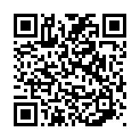
Before you go . . . we’d love your feedback
Scan the QR code to take our 2–3 minute survey
Your input helps us:
Improve future CHCF events
Shape topics that matter most to you
Better support your work and region
Thank you for being part of today’s conversation.

