Slide 1





Notes:
Advances in medicine have transformed our society. Fewer people today die of infectious disease, and more people are living longer. But in addition, more people are living longer with serious and chronic illnesses. Many of these patients live with the ongoing physical, functional, mental, and emotional effects of their health conditions. To improve their care, a new field of medicine has emerged. It is called palliative care.

Slide 2


Interpreting in Palliative Care
Produced with the support of the California HealthCare Foundation
www.chcf.org
Notes:
Even interpreters with professional training and solid experience will find that interpreting in palliative care requires some special techniques and vocabulary. That’s why the California HealthCare Foundation has created this program: to help interpreters be better prepared to interpret in palliative care and end-of-life encounters.

Slide 3
Palliate =
to make less severe
In health care, to palliate means to lessen the severity of pain or disease without curing or removing the underlying cause.
Notes:
But what is palliative care? Palliative care is a relatively new field of medicine. The name comes from the term “palliate,” which means, to make less severe or intense. In medicine, “palliate” means to lessen the severity of pain or disease without curing or removing the underlying cause. So, for example, palliative chemotherapy usually aims to shrink or slow the growth of a cancer, not to cure the cancer. Palliative radiation therapy usually helps lessen symptoms like shortness of breath, confusion or pain, but will not make the tumor go away. And palliative care in general focuses on improving the overall quality of life for people facing serious or life-threatening illness, not on curing the cause of the illness.

Slide 4
Remember this!
Palliative care
treats,
prevents, or
relieves
the symptoms
of a serious or chronic illness
but does not cure it.
Notes:
So this is this first important point. Palliative care treats, prevents or relieves the symptoms of a serious or life-threatening illness, but it does not cure it.

Slide 5


Remember this too!
Palliative care + curative care
OR
Palliative care alone, when curative care is no longer helpful.
Notes:
The second important thing to remember about palliative care is that it can be delivered at any time in a patient’s illness. It can be delivered at the same time as curative treatment, or it can be delivered by itself, when further curative treatment wouldn’t be useful. The ultimate goal is to improve quality of life for patients who are facing serious illness, as well as for their family and friends.

Slide 6

In a nutshell
Palliative care
improves the quality of life
for patients who are facing serious illness
as well as for their family and friends.
Notes:
So, in a nutshell, palliative care improves the quality of life for patients who are facing serious illness as well as for their family and friends.

Slide 7

Palliative care
Hospice care
Pain management
Comfort care
Notes:
When a patient is approaching the end of life, you may hear various terms to describe the patient’s options for care. In addition to “palliative care,” you may hear terms like “hospice care”, “pain management”, and “comfort care.” How are these related?

Slide 8




BOTH palliative care and hospice . . .
Notes:
These various types of medical care have a lot in common. Both palliative care and hospice emphasize comfort and quality of life for patients who have serious illnesses. Both seek to provide comprehensive, holistic care, addressing spiritual and psychosocial issues in addition to physical symptoms. Both are provided by multi-disciplinary teams, and both address patients together with their families.

Slide 9


Hospice . . .
Notes:
However, hospice care is a specialized form of palliative care, offered to patients who are expected to die within six months and who no longer desire life-prolonging treatments. Unlike hospice patients, patients receiving palliative care may still be getting treatments whose main purpose is to prolong life.

Slide 10



Hospice . . .
Notes:
There are other differences as well. Hospice care can be provided at home (advance), in a nursing or assisted living facility, or in an inpatient hospice, but it is NOT usually provided in the hospital. Also, hospice has its own payment structure and regulations under Medicare and Medicaid.

Slide 11
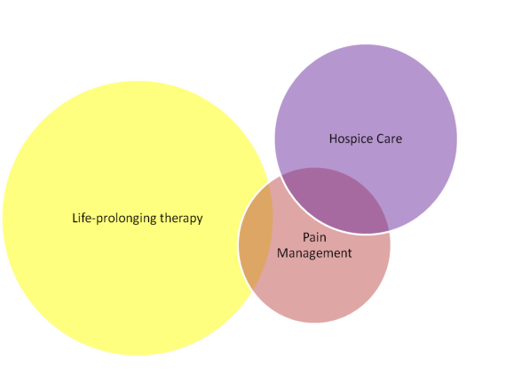
Palliative
Care
Graphic by Anne Kinderman, MD; used with permission.
Notes:
This graphic can help explain the relationship between the various forms of care. Usually life-prolonging therapy and hospice care do not overlap. Hospice is a specialized form of palliative care. Pain management can be part of all three of these, but each does more than just manage pain. And the management of chronic pain is usually different than all of them.

Slide 12

But what about “comfort care”?
Notes:
You may hear the term “comfort care.” Some people us this term to mean the same thing as palliative care. Sometimes it means "comfort measures only" and is closer to the meaning of hospice care.

Slide 13
Palliative care provides:
Time for meetings and counseling.
Expertise in managing physical and emotional symptoms.
Support in resolving conflicts.
Coordination of care across settings.
Notes:
So, let’s look at what palliative care services include. According to the Center to Advance Palliative Care, “Palliative care programs support the primary physician and the patient by providing time to devote to intensive family meetings and patient/family counseling; expertise in managing complex physical and emotional symptoms such as pain, shortness of breath, depression and nausea; support for resolving questions and conflicts between families/patients and physicians concerning care goals, DNR orders and treatment requests, and coordination of care across health care settings.”

Slide 14








Palliative Care . .
. .is a team effort!
Notes:
Clearly, providing all these services requires a range of knowledge and skills that spans various disciplines. This is why palliative care is delivered in teams. While teams differ by facility, a palliative care team often includes one or more physicians who specialize in palliative care, nurses, social workers and chaplains. Palliative care is definitely a team effort.

Slide 15
Palliative care teams help with:
Establishing goals of care
Managing symptoms
Patient discharge
Difficult conversations
Notes:
Doctors may call for a palliative care consult for a variety of reasons. Perhaps they want to clarify the patient’s “goals of care.” Or they may need help in managing a patient’s pain or other symptoms. A palliative care team can also help a physician in planning for a patient discharge. The team is often called to help with difficult communication situations such as breaking bad news or discussing withdrawal of life-prolonging treatments.

Slide 16



Notes:
So what does all this mean for an interpreter? First of all, if you are called to interpret for a palliative care consult, it means that you will probably be interpreting for a patient who feels quite ill. The patient may or may not be dying. There may be difficult issues discussed, and difficult decisions may have to be made. Certainly, the encounter will be longer than the common interpretation and may include family members or multiple caregivers.

Slide 17
Remember
You are interpreting meaning.
Are there messages communicated only by context, tone or word choice?
Are there cultural issues?
Notes:
One important thing to remember is that palliative care teams are not just concerned with what the patient or family says, but about the underlying meaning – what we call “the subtext.” Are there messages that are not being communicated through words? Are there cultural issues that are impacting the communication? It is especially important that doctors be made aware of these things so that they can inquire more deeply.

Slide 18


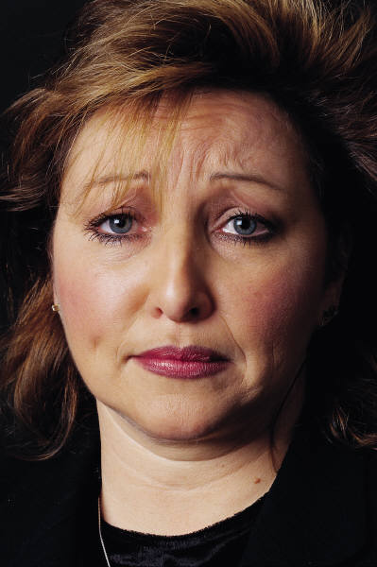
Notes:
As I mentioned, palliative care conversations, can be difficult. You may be surprised to hear that physicians often have very limited training in communication and end-of-life care and may themselves have difficult with sharing bad news or shifting the conversation from curing a disease to reducing its symptoms. Add cultural and linguistic differences to the mix, and providers may not be as skillful at these conversations as we would all wish. When clinicians feel uncomfortable, and when patients and families get upset too, the interpreter may often feel caught in the middle. It is normal to want to escape from things that are painful or difficult -- doctors, nurses, social workers, patients, families, and interpreters as well. But the more you know, the better you will be at helping these difficult discussions go more smoothly for everyone involved.

Slide 19
Palliative care emphasizes
Maximizing quality of life.
Management of pain and symptoms.
Communication among the treating physicians.
Coordination of medical and supportive services.
Assistance with patient decision-making about care.
Support for caregivers.
Delivery by a team, including interpreters.
Notes:
So, here’s a quick review.
Palliative care is an approach to treatment that focuses on helping patients with serious or advanced illnesses to maximize their quality of life. It emphasizes management of pain and symptoms, communication among the treating physicians, coordination of medical and supportive services, assistance with patient decision-making about care, and support for caregivers. It is delivered by a team, and, for patients and families with limited English proficiency, interpreters are a key part of the team.

Slide 20

Notes:
Questions, anyone?

