Slide 1
An Introduction to Palliative Care for Health Care Interpreters
Cynthia Roat, MPH
Anne Kinderman, MD
Alicia Fernandez, MD
Notes:
The goal of this presentation is to introduce you to the fields of hospice and palliative care.
PAGE ADVANCE

Slide 2


Interpreting in Palliative Care
Produced with support from the California HealthCare Foundation
www.chcf.org
Notes:
In 2008, the California HealthCare Foundation started a multi-million-dollar initiative to expand the understanding and use of palliative care in the public hospitals in California.
As part of this initiative, the Foundation recognized the importance of professional health care interpreters in providing high-quality palliative care for the growing number of patients in the United States with limited English proficiency.
In response, the Foundation created a curriculum for on-site trainers to prepare interpreters to work in palliative care settings, and supported local trainings throughout California. Then, in order to make this important information even more widely available, the Foundation developed the on-line training that you are now taking.
PAGE ADVANCE

Slide 3
What will you learn?
At the end of this presentation, you’ll have a clear understanding of:
What palliative care is
How palliative care is provided
How palliative care relates to other types of care
Hospice care
Comfort care
Pain management
Why interpreters are critical to providing palliative care
Notes:
This presentation is designed to teach you some basic information about the field of palliative care. (advance) When you’re done, you’ll have a clear understanding of: (advance)
What palliative care is (advance)
How palliative care is provided (advance)
How palliative care relates to other types of care (for example, (advance) hospice care, (advance) comfort care, and (advance) pain management); and (advance)
Why interpreters are critical to providing palliative care
PAGE ADVANCE

Slide 4


Why do we need palliative care?
Notes:
As we explore these issues, the first question to address is: Why do we need palliative care? (advance)
Advances in medicine have transformed our society. 100 years ago, we didn’t have antibiotics or vaccines, and many work environments were unsafe. People often died suddenly, of infections or accidents. As a result, in 1911, (advance) average Americans only lived into their early fifties.
PAGE ADVANCE

Slide 5





Notes:
With incredible advances in medications, medical knowledge, and technology, people are now living much longer. (advance) In 2006, average Americans lived into their late seventies. (advance) The major causes of death in the United States now are chronic illnesses, like heart disease and cancer. (advance) As a result, more people are living longer, (advance) but they often spend many years living with serious and chronic illnesses. Many of these patients live with the ongoing physical, functional, mental, and emotional effects of their health conditions.
Although longer life expectancy is a wonderful thing, we now have many medical technologies and treatments that some people may not want, for personal or moral reasons. Over the past 35 years, there have been several cases in which families fought in the court systems to allow loved ones to die naturally, off of machines. You may remember the case of Terry Schiavo, who died in 2005, after living in a persistent vegetative state for many years.
To improve the care for people living with serious illnesses, and to ensure that people get the type of care that they actually want, a new field of medicine has emerged. It is called palliative care.
PAGE ADVANCE

Slide 6

Pallia – what?
Notes:
But what is palliative care? Palliative care is a relatively new approach to care for people with serious illness. It is also the name for a field of medicine that was first recognized as its own subspecialty in 2006.
PAGE ADVANCE

Slide 7
Palliate =
to make less severe
From two Latin terms
pallium:
an outer garment or cloak
palliare: to cloak
In health care, to palliate means to lessen the severity of the symptoms of an illness without curing or removing the underlying cause.
Notes:
The name “palliative care” comes from the term “palliate,” which means, to make less severe or intense.
One way to remember what this specialty does is by learning where the word came from originally. (advance) It came from the Latin term for an outer garment or cloak. This conveys the idea of covering over something underneath, as well as shielding the person from the elements. In putting on a cloak, we don’t remove or change what’s underneath, and we’re preparing for the external things that affect us. (advance)
In medicine, “palliate” means to lessen the severity of the symptoms of an illness without curing or removing the underlying cause. There are some diseases, like emphysema, or ALS (also known as Lou Gherig’s Disease) for which we have no cure. So, in a sense, all of the treatments for these diseases are palliative. For other diseases like cancer, some treatments can be curative, but others are palliative. So, for example, palliative chemotherapy usually aims to shrink or slow the growth of a cancer, but not to cure the cancer. Palliative radiation therapy usually helps lessen symptoms like shortness of breath, confusion or pain, but will not make the tumor go away.
PAGE ADVANCE

Slide 8
Remember this!
Palliative care
treats,
prevents, or
relieves
the symptoms
of a serious or progressive illness
but does not cure it.
Notes:
So this is this first important point. Palliative care (advance) treats, (advance) prevents or (advance) relieves (advance) the symptoms of a serious or life-threatening illness, but it (advance) does not cure it.
It’s important to address symptoms, because we know that we don’t do a very good job at this, as a medical system.
A major study in the 1990s found that among patients who died in the hospital, family members reported that their loved one experienced moderate to severe pain more than half the time in the last week of life.
We also know that patients with chronic illnesses like heart failure frequently report distressing symptoms. Some studies report that 78% of patients with heart failure struggle with pain, 60% have shortness of breath, and 69% have depression.
Most of the time, healthcare providers focus on treating the underlying illness, rather than the symptoms. But palliative care is different: it focuses on managing symptoms, to try to improve the quality of life of patients, and their families.
PAGE ADVANCE

Slide 9

Palliative care is for patients and their families and caregivers
Notes:
Palliative care extends beyond the patient, and sees the entire family as the focus of care.
We work with whole families because we recognize that serious illness affects not just the patient, but their families and caregivers as well.
For example, a serious illness can mean that a patient’s spouse or children may need extra help to care for their loved one, or to cope with their own emotions or social stresses. Caring for a loved one might result in having to miss work or give up a job and often creates personal or emotional stress.
We know that caring for a sick family member can take a toll: caregivers are themselves have higher risks of serious illness, likely from the strain and stress of dealing with their loved one’s illness. For this reason, we always encourage family members and caregivers to be in close contact with their own primary care providers.
PAGE ADVANCE

Slide 10

Palliative care also focuses on understanding a patient or family’s values, to help guide medical care
“When you think about the future, what do you hope for?”
“If you knew your time were short, are there certain things you’d want to be able to do, or see, or experience? Where would you want to be?”
Notes:
Palliative care also focuses on understanding a patient or family’s values, to help guide medical care.
How do we know what an individual’s or family’s values are? We have conversations with them – often more than one! – and ask a lot of questions.
Some typical questions that might come up would include: (advance)
“When you think about the future, what do you hope for?” (advance) or
“If you knew your time were short, are there certain things you’d want to be able to do, or see, or experience? Where would you want to be?”
Values and hopes often change over time, so these conversations have to happen on a regular basis, throughout the course of illness.
Through these conversations, doctors and nurses come to understand a patient’s or family’s values and can then recommend the treatments that are consistent with those values. Sometimes, this leads to the creation of documents like living wills, or to a physician making advance treatment plans, like orders for various life-sustaining treatments.
PAGE ADVANCE

Slide 11
When can palliative care start?
100
bereavement
Curative care
%
focus
Hospice Care
Palliative Care
Diagnosis of
serious illness
Terminal phase
of illness
Death
Time
Adapted from S Pantilat, PCLC 2005
Notes:
When can patients and families get palliative care?
This diagram can be helpful in explaining when patients can start receiving palliative care. Along the bottom, looking left to right, we move from the time when a serious illness is diagnosed, through the weeks and months after someone dies, to the far right.
Up the side, looking from bottom to top, we look at the amount of energy the health care team spends on different types of care: curative care (in dark purple), which tries to cure disease or prolong life; and palliative care (in blue), which tries to ease the suffering that comes along with serious illness.
Patients can start receiving palliative care from the very beginning, when they receive the diagnosis of a serious illness. Palliative care can offer a variety of different things, depending on how advanced a patient’s illness has become.
In the early phase of illness, palliative care usually focuses on managing symptoms, and starting to understand a patient’s or family’s values, so that those values can be applied to the present and future medical choices that a patient has.
As the illness progresses into the terminal phase, and there are fewer and fewer treatments that will be helpful in prolonging life or curing the illness, palliative care gradually takes on a more important role. This is important because often a patient’s symptoms may get worse over time, and families may need more support over time.
At the point at which a patient has only a short time left, and no longer wants to (or no longer can) pursue aggressive life-prolonging treatments, he or she becomes eligible for hospice care. We’ll talk more about hospice care later.
But care doesn’t stop when a patient dies. In purple, you see that care continues, for the surviving friends and family. Through hospice care, the grieving family can continue to get emotional support for a year or more.
PAGE ADVANCE

Slide 12


Another important point to remember:
Palliative care + curative care
OR
Palliative care alone, when curative care is no longer helpful
Notes:
So, the second important thing to remember about palliative care is that it can be delivered at any time in a patient’s illness. (advance) It can be delivered at the same time as curative treatment, (advance) or (advance) it can be delivered by itself, when further curative treatment wouldn’t be useful.
Patients, you, or your family members shouldn’t have to wait to get palliative care until there are no longer any curative options for treatment. It can start much earlier, so that the patient and family can get the most benefit.
PAGE ADVANCE

Slide 13

In a nutshell
Palliative care
aims to improve the quality of life
for patients who are facing serious illness
as well as for their family and friends.
Can be provided at any time
Notes:
So, in a nutshell, palliative care (advance) seeks to improve the quality of life (advance) for patients who are facing serious illness (advance) as well as for their family and friends. And (advance) it can be provided at any time in the course of a serious illness.
PAGE ADVANCE

Slide 14

How and where is palliative care provided?
Notes:
So far we’ve talked about what palliative care is, and when it can be provided. The next big questions that often come up are how and where palliative care is provided.
Let’s look at where palliative care is provided first. (advance)
Palliative care is most often provided in hospitals, by an inpatient consultation service. Consultants give their advice to the primary medical or surgical team caring for the patient. (advance)
Palliative care is also sometimes provided in an outpatient clinic. Palliative care is a relatively new subspecialty, and outpatient palliative care is a relatively new way to provide palliative care, so there aren’t too many of these clinics yet. (advance)
Palliative care can also sometimes be provided in nursing homes, by palliative care teams. (advance)
And sometimes it can be provided in the home, by home healthcare agencies or hospice agencies that have special palliative care programs.
The goal of all of these different palliative care services is to help manage symptoms, understand a patient’s or family’s values so that they can make the best medical decisions, and provide necessary support throughout the course of illness, wherever the patient is.
PAGE ADVANCE

Slide 15








Palliative care . .
. .is a team effort!
Notes:
Who provides palliative care? (advance)
As we’ve discussed, palliative care is holistic. It addresses not just the physical symptoms, but the emotional, social, and spiritual aspects of serious illness. (advance)
Since different health care providers have different types of training, and therefore have different expertise, palliative care is interdisciplinary. (advance)
Palliative care teams often include some combination of (advance) doctors, (advance) nurses, (advance) social workers, chaplains, (advance) psychologists, and/or pharmacists. And when the patient and provider don’t speak the same languages, (advance) the interpreter becomes an essential part of the palliative care team.
PAGE ADVANCE

Slide 16
Palliative care provides:
Time for family meetings and patient/family counseling
Coordinating interdisciplinary meetings to discuss prognosis and treatment options
Establishing goals of care
Expertise in managing physical and emotional symptoms
Notes:
But what do palliative care teams do?
The Center to Advance Palliative Care describes 4 main aspects of palliative care that we’ll cover on the next 2 slides.
Let’s look at each of these aspects (advance)
Palliative care teams dedicate a significant amount of their time to family meetings and patient or family counseling. This is the primary way that interpreters will be involved as part of the palliative care team. In modern medicine, primary medical or surgical teams are being asked to do more and more, making it sometimes difficult to devote the time needed to fully understand a patient or family’s wishes or concerns. When treatment decisions need to be made, a palliative care team may help (advance) coordinate and facilitate a “family meeting” involving the patient, family, and other important healthcare providers, such as oncologists, surgeons, nurses, rehab specialists, etc. Often these meetings involve discussing prognosis, treatment options, or (advance) establishing what we call the “goals of care.”
Palliative care teams also have (advance) special expertise in managing the physical and emotional symptoms that accompany serious illness. For example, a palliative care specialist might help treat symptoms like pain, shortness of breath, nausea, depression, anxiety, and more. The treatments a palliative care specialist will recommend will often include medications, as well as simple caregiving interventions.
ADVANCE

Slide 17
Palliative care provides:
Support in resolving conflicts
Goals of care
DNR orders and treatment requests
Coordination of care across settings
Patient admission, discharge
Notes:
Palliative care also provides (advance)
Support for resolving conflicts – When a patient’s life is at stake, tensions run high, for patients and their families, but also for healthcare providers. Families fear the loss of a loved one, and healthcare providers may feel as if they’ve failed, even if they know that death is an inevitable part of life. In addition to those emotional tensions, modern life support technologies have created ethical tensions so that healthcare providers fear that, in some cases, our treatments have shifted from prolonging life to prolonging death. In situations like this, conflicts can arise between healthcare providers, within families, or between healthcare providers and families. These conflicts may involve (advance) the patient’s goals of care, (advance) DNR orders and treatment requests, or other subjects related to the patient’s life or illness. Palliative care consultants can come into these high-tension situations and try to mediate and resolve conflict, as neutral parties trying to hear and understand both sides.
Palliative care also provides (advance) Coordination of care across settings – Palliative care consultants can follow patients across settings inside of the hospital (for example, from the emergency department to the ICU to the medical/surgical ward and the rehabilitation unit). When the patient is ready, the team can then (advance) help make preparations for a patient’s care after they leave the hospital. Outpatient palliative care teams can also help coordinate hospital admissions and communicate preferences that the patient has for his or her care during hospitalization. We know that patients are very vulnerable during care transitions, so having this continuity is increasingly important.
PAGE ADVANCE

Slide 18
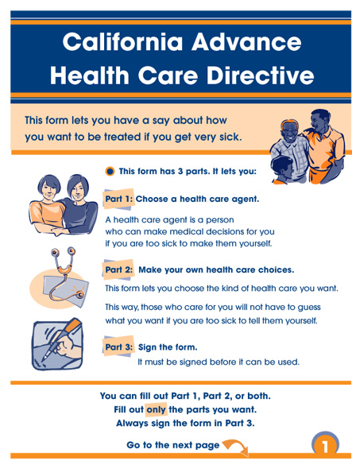

Palliative Care Teams may help patients and families complete Advance Directives
Notes:
One specific task that palliative care teams sometimes assist with is called “Advance Care Planning.” Advance Care Planning is a process that usually involves multiple conversations over time, and may or may not result in completion of an advance directive or living will.
On this slide you see two standard types of advance directives. It’s helpful for you to be familiar with these forms, because interpreters may be asked to help facilitate discussions about advance directives, between healthcare providers and patients. It should be noted, though, that all of the forms presented in this slide and the next slide are already available in multiple languages.
The image on the left is the “low-literacy” advance directive used in California. This form was developed to be comprehensible for individuals with a 5th grade reading level. It has a lot of pictures and graphics, and it has been well-accepted by patients. Your state may not have a “low literacy” advance directive, so the forms you use may just look like long legal documents. A few other states are trying to develop their own low-literacy Advance Directive forms, similar to California’s, because this form has been very well-received among Californians with limited English proficiency.
The image on the right is of another standard Advance Directive, known as the “Five Wishes” form. Like other advance directives, it allows individuals to designate a surrogate decision-maker (also known as a Durable Power of Attorney for Health Care), as well as express what they do and don’t want for their future treatments. The 5 Wishes booklet is honored as a formal legal document by 42 states in the US.
PAGE ADVANCE

Slide 19

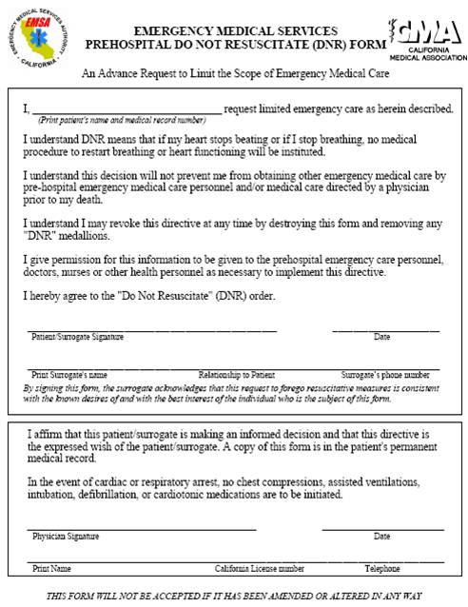
Physicians may also help complete specific orders for future treatment(s)
Notes:
Interpreters may also be asked to assist with discussions about physician orders for future treatments. Here are two of the most common forms used in California. These are the forms that will be used in the sight translation exercises of this course. If you work outside of California, your state may have its own versions of both of these forms, but they will probably use many of the same concepts and vocabulary.
The image on the left is the “POLST” form, which stands for Physician Orders for Life-Sustaining Treatment. It’s supposed to be printed on bright pink paper so that it’s easily identifiable in the medical record, but it’s accepted in plain white, too. It is honored in any setting of care – hospital, home, nursing home, or outpatient clinic. It allows the patient and physician to communicate preferences for emergency care like resuscitation, hospitalization, and artificial nutrition. It is currently available in 9 languages.
The image on the right is the “Pre-hospital Do Not Resuscitate (or DNR) Form.” This is another way that individuals can communicate preferences to avoid CPR or other resuscitation attempts outside of the hospital. It is currently available in 7 languages in this program.
PAGE ADVANCE

Slide 20

Palliative care
Hospice care
Pain management
Comfort care
Notes:
By now we’ve discussed palliative care in detail.
The next thing that confuses people about palliative care is terminology. (advance) Sometimes you hear terms like (advance) “hospice care”, (advance) “pain management”, and (advance) “comfort care” used almost interchangeably with “palliative care.” (advance)
In reality, they are not the same – they all describe different, but related, types of care. Let’s explore how these terms are related.
PAGE ADVANCE

Slide 21




What is hospice care?
Notes:
Let’s talk about hospice care first. When people first hear the word “hospice,” they often think of a specific place. In reality, hospice is a type of care, that can be provided in many different settings. In the U.S., hospice care is most often provided in the patient’s home.
So, what is hospice care?
Hospice care is a specialized form of palliative care, for people who are coming to the end of life, who want to maximize comfort
People usually stop invasive medical procedures or aggressive life-prolonging treatments so that they can spend as much time as possible at home (or in a home-like medical facility)
Nurses make visits to patients receiving hospice care to assess for any type of suffering (this includes physical, emotional, social, or spiritual suffering). They then seek help from other team members to address those problems:
They might consult with the team physician or patient’s primary care doctor about using medications to treat the patient’s symptoms;
They might request visits from health aides or volunteers to provide companionship and care for patient and/or family;
They might ask the spiritual care provider (or chaplain) to make a visit; or,
They may request help from the social worker to address issues of social/relational strain or getting more help for the family
It’s important to be aware that many people already have ideas about what “hospice” is. Sometimes they are right, but other times they have misinformation. (advance)
In some cases, people have never heard of hospice care, and they need more basic information. It is important for the providers to assess and understand the patient’s or family’s literacy level and their understanding of hospice, before describing hospice care in more detail. (advance)
Some people may have had a loved one receive hospice care in the past, and may have had a positive experience with it. These people likely don’t need much more information. In this case, the providers will likely just talk about the specific care that would be provided, where it would be provided, and who would provide it. (advance)
Some people may become fearful or shocked when the idea of hospice is introduced. This can be for a variety of personal or cultural reasons.
In the United States, because hospice eligibility depends on the patient having a limited prognosis, patients are often only referred for hospice services at the very end of life, often in their final days or weeks. Family members may not realize that a patient is this sick.
Another reason why people might be surprised is because the word “hospice” means different things in different cultures. Or the concept may not exist at all. This is particularly important for interpreters to know and understand.
For example, in Spanish, the word “hospicio” can mean a place where the elderly are abandoned to die, a mental institution, or an orphanage. It often is associated with negative feelings and fear. So this is not a good translation for hospice. However, there really isn’t another term that is accurate and readily understood. So that the patient doesn’t react to the word without understanding how it is being used, it would be appropriate to alert the provider and suggest that he or she explain what hospice care is like in the U.S.
PAGE ADVANCE

Slide 22


Hospice is for people with limited
life-expectancy
Notes:
As we discussed, people are only eligible for hospice care if they choose to forego aggressive life-prolonging treatments, and if their life expectancy is short. Technically, two doctors need to “certify” that, if the disease takes its expected course, the patient is likely to pass away in the next six months.
Some patients live longer than expected, which means that they live more than 6 months. If the patient’s condition has continued to decline over the first six months of hospice care, then the patient usually stays in hospice care. Sometimes, the patient’s condition has actually improved, and the patient is discharged from hospice care because the providers think that the patient will live longer than 6 months.
PAGE ADVANCE

Slide 23

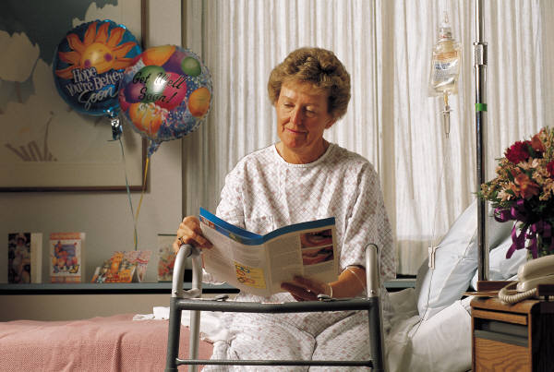

Hospice . . .
Notes:
Another difference between hospice care and palliative care is where they’re provided. (advance)
Hospice care is usually provided in the home, or (advance) a home-like setting like a nursing facility, if patients are there for “long-term care”. Sometimes hospice care is provided in a specialized care facility known as an “inpatient hospice.” In California, inpatient hospices are relatively rare; but in some other states, they’re more common. (You can ask your colleagues or social workers if there are any inpatient hospice facilities in your area.)
Unlike palliative care, (advance) hospice care is almost (advance) never provided in the hospital. This is because of the way hospice care is reimbursed, as well as the fact that hospitals usually specialize in acute care, which often involves invasive testing or procedures. Hospice care usually tries to maximize comfort, and minimize unnecessary testing and procedures.
Hospice care is best for people who prefer NOT to have to go back to the hospital. For this group of people, hospice care is actually a very good fit, because it allows them to maximize their time at home, and avoid transferring back and forth from the hospital in their last weeks and months of life.
PAGE ADVANCE

Slide 24



BOTH palliative care and hospice . . .
Notes:
So, as you can see, there are differences between palliative care and hospice care. But how are they similar? (advance)
Both palliative care and hospice emphasize comfort and quality of life for patients who have serious illnesses. (advance)
Both seek to provide comprehensive, holistic care, addressing spiritual and psychosocial issues in addition to physical symptoms. (advance)
Both are provided by multi-disciplinary teams, and (advance)
Both address patients together with their families.
PAGE ADVANCE

Slide 25
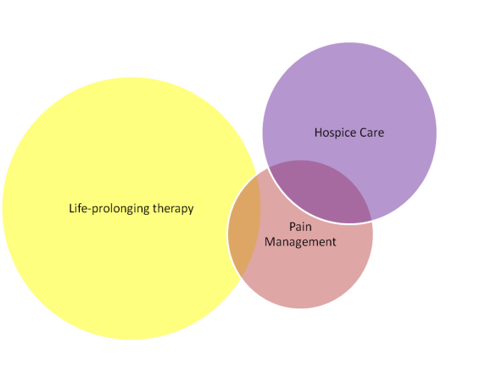
Palliative
Care
Notes:
This diagram can also help clarify the relationship between hospice care, palliative care, and pain management.
We’ve described “hospice care” as a specialized form of palliative care – so you can see that it’s a smaller purple bubble within “palliative care.” This is because patients are only eligible for hospice care if they have a limited prognosis of less than 6 months, and if they agree to stop aggressive life-prolonging treatments. So, as you can see, the “life-prolonging therapy” bubble (in yellow) and the “hospice care” bubble don’t overlap.
How is pain management related?
As you can see, there is significant overlap between palliative care and pain management, and hospice care and pain management. This is because pain is a very common symptom for people with serious illness, and by now you know that symptom management is an important component of both palliative care and hospice care.
However, sometimes people develop chronic pain that is not associated with a serious illness – such as with osteoarthritis or sports injuries. Their life expectancy is not shortened, and they have no incurable illnesses. Management of chronic pain, when it is the only symptom to be addressed, is usually outside of the scope of palliative care.
PAGE ADVANCE

Slide 26

But what about “comfort care”?
Notes:
You may also hear the term "comfort care.“ This can be confusing.
Some people us this term to mean the same thing as palliative care. Other times it means "comfort measures only" and is closer to the meaning of hospice care.
So, how do you know what the person means by comfort care? It is best to try to understand the meaning by the context, or by the way it’s usually used at that institution. For example, at some hospitals, “comfort care” is only used to describe hospice-type care provided in the hospital, usually in the last hours or days of a patient’s life.
If you’re unsure about how this phrase is being used by a speaker, ask for clarification.
PAGE ADVANCE

Slide 27

What is the role of the interpreter in palliative care encounters?
Notes:
We’ve talked about what hospice and palliative care are, and where they’re provided, but what is the role of the interpreter in palliative care encounters?
When a patient and provider do not speak the same language, an interpreter becomes a crucial component of the palliative care team. Like the interdisciplinary providers on the team, the interpreter brings his or her special expertise – in this case, bilingual communication – to provide the best possible care for the patient and family.
Functionally, the interpreter’s role and responsibilities are the same in palliative care as they are in other health care encounters. The interpreter is asked to accurately convey meaning from patient to provider, and provider to patient.
There are some challenges that are unique to interpreting in palliative care, though. For example, there is specialized vocabulary that you may not have heard before. Patients and providers may be quite indirect in what they say, making it hard to understand what message they are really trying to convey. Also, cultural and religious differences can lead to painful misunderstandings. And sometimes, just having to interpret for someone you know to be dying can be hard. We’ll be addressing all of the challenges later in the course.
PAGE ADVANCE

Slide 28
Remember
Interpreters are asked to convey meaning, not just convert words.
Are there messages communicated only by context, tone or word choice?
Are there cultural issues?
Notes:
One key thing that interpreters should know is that palliative care teams are concerned not just with what words are said, but what patients and families really mean.
Sometimes the interpreter may get a sense that there are underlying messages that aren’t coming across in the words alone. The message might be perceived by the interpreter through the patient or family’s context, tone, or word choice.
Sometimes the message comes through in body language, or side comments between family members.
Sometimes there are cultural issues that the provider might not be aware of.
THESE MESSAGES ARE ALL CRITICALLY IMPORTANT FOR THE PROVIDER TO KNOW. Interpreters need to know that they can and should interrupt the flow of the session to convey the underlying messages or meaning, if the interpreter is concerned that the provider is missing something. If it is impossible to interrupt the flow of conversation, at a minimum, the interpreter should inform the provider of the underlying message after the encounter.
PAGE ADVANCE

Slide 29



Notes:
In addition to knowing what to do in these encounters, we also want interpreters to be able to prepare for some of the unique aspects of palliative care encounters.
When interpreters are called to help interpret for a palliative care encounter, this likely means that (advance) the patient may be very sick, or might feel quite ill. Sometimes the patients will be close to dying, other times they will not even know they have a serious illness (advance)
Interpreters should also know that palliative care encounters often take a lot of time. This is because it takes special care to approach difficult topics in conversation, especially with patients and families that the team hasn’t known for very long – often they’ve never met! Interpreter supervisors should be aware when an interpreter is being called to a family meeting or a palliative care consult, so that he/she will not expect the interpreter to be ready to take another call for an extended period of time. (advance)
The other thing that interpreters should prepare for is the content of the conversation. Oftentimes serious issues will be discussed, and decisions need to be made. This can be stressful for the provider, for the patient and family, and for the interpreter. We know that these are “high-stakes” conversations, and the heightened importance of accurate interpretation can mean high stress for the interpreter.
PAGE ADVANCE

Slide 30


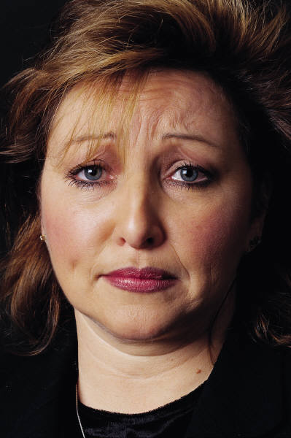

Notes:
There are some common reasons why these conversations can be stressful for the interpreter. (advance)
Interpreters may be surprised to hear that physicians often have very limited training in communication and end-of-life care, and may themselves have difficulty with sharing bad news or shifting the conversation from curing a disease to reducing its symptoms. This puts the physicians on edge, even before the conversation has started. (advance) And of course, the patient and family may be emotional, because the conversation may mean that the patient is very sick, or even approaching death. In these conversations, (advance) the interpreter is in the middle, and sometimes may feel like he or she absorbs the stress from one or both sides.
In addition, the content of these conversations is often difficult. Illness and death are often difficult or even “taboo” subjects, particularly in some non-American cultures. The interpreter may even come from one of these cultures and may feel uncomfortable having to speak directly about these subjects.
And finally, these conversations can be stressful because of the interpreter’s own personal experience. Interpreters are people, too! They have family members and close friends who get sick and die. Sometimes they even know the patient or family from their own community. When these personal issues come up, as they frequently do, it is important for the interpreter to know how best to handle the situation.
Because of the stress that can be involved in these conversations, we have included a module in this course that deals with managing stress and dealing with one’s emotions.
PAGE ADVANCE

Slide 31
Palliative care emphasizes
Maximizing quality of life
Management of pain and symptoms
Communication among the treating physicians
Coordination of medical and supportive services
Assistance with patient decision-making about care
Support for caregivers
Delivery by a team, including interpreters
Notes:
So, here’s a quick review of what we’ve talked about in this introduction to hospice and palliative care.
Palliative care is an approach to treatment that focuses on helping patients with serious or advanced illnesses (advance) to maximize their quality of life. (advance)
It emphasizes management of pain and symptoms, (advance)
communication among the treating physicians, (advance)
coordination of medical and supportive services, (advance)
assistance with patient decision-making about care, and (advance)
support for caregivers. (advance)
It is delivered by a team, and, for patients and families with limited English proficiency, interpreters are a key part of the team.
PAGE ADVANCE

Slide 32

"You matter to the last moment of your life, and we will do all we can, not only to help you die peacefully, but to live until you die.“
-Dame Cecily Saunders
Notes:
I’ll finish with a quote by Cecily Saunders, who is widely accepted as the person who launched the modern hospice movement. She founded St. Christopher’s Hospice in London in 1967, and pioneered the idea of holistic, interdisciplinary care for people with serious illness.
She said, “You matter to the last moment of your life, and we will do all we can, not only to help you die peacefully, but to live until you die.”
PAGE ADVANC E

Slide 33

Thank you
Notes:
We are so pleased that you have chosen to take the time to strengthen your skills in palliative care interpreting. It is our sincere hope that this information will help you do your job better, and with greater confidence. After all, without you, doctors like myself would be unable to give the care we were trained to give, and patients and their families would be unable to get the care they seek and deserve. For the large number of Americans with limited English proficiency, you are the key to communication, which also means that you are the key to providing effective palliative care.

