Slide 1
San Joaquin Valley:
Some Hospitals Struggle Financially, and Access Challenges Grow, as Medi-Cal Cuts Loom
Len Finocchio, DrPH
Yegian Health Insights
February 5, 2026

Slide 2
Agenda
01 | Welcome and Project Overview — Sandra Hernández, MD
02 | Summary of Study Findings — Len Finocchio, DrPH
03 | Panel Discussion with Regional Experts Marc Mertz, MHA, FACHE, CEO, Kaweah Health Simon Paul, MD, Public Health Officer, Madera County Justin Preas, President and CEO, United Health Centers Eva Terrazas, Chief Public Policy and Advocacy Officer, Pacific Clinics Kristof Stremikis, MPP, MPH, Director, Market Analysis & Insight, CHCF
04 | Audience Q&A
3

Slide 3
Project Overview
The purpose of the study is to gain key insights into the organization, financing, and delivery of care in communities across California and over time. This is the fifth round of the study; the first set of regional reports was released in 2009.
The markets in the 2025 study are Inland Empire, Los Angeles, Sacramento, San Diego/Imperial, San Francisco Bay Area, San Joaquin Valley, and Shasta/Lassen.
The Yegian Health Insights consulting team includes Jill Yegian, Ted Calvert, Caroline Davis, Len Finocchio, Marian Mulkey, Katy Wilson, Alwyn Cassil, Karen Shore, and Jessica McLaughlin.
Seven reports, along with webinars or in-person events, will be released in 2026.
4

Slide 4

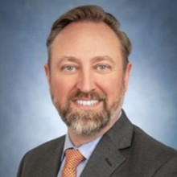



Panelists
Len Finocchio, DrPH
Marc Mertz, MHA
Simon Paul, MD
Justin Preas
Eva Terrazas
5

Slide 5

Approach and Information Sources
This Regional Market Study tells the story of the health care landscape and developments over the last five years.
Counties included in the region:
  Fresno
  Kings
  Madera
  Mariposa
  Tulare
Interviews with 25 regional leaders representing:
  Health plans
  Hospitals, IPAs, clinics, behavioral health providers
  County government
  Regional experts
Analysis of:
  Quantitative data from the California Department of Health Care Access and Information (HCAI), surveys, US Census, and other sources
  Industry reports, journal articles, and news stories
San Joaquin Valley
6

Slide 6
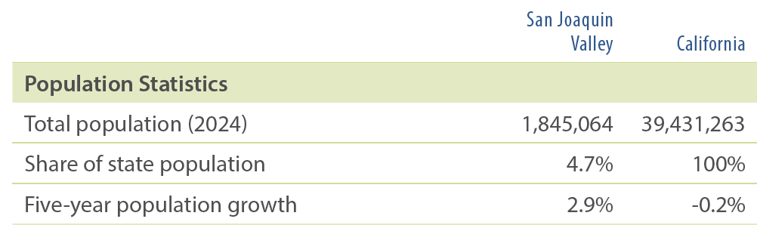
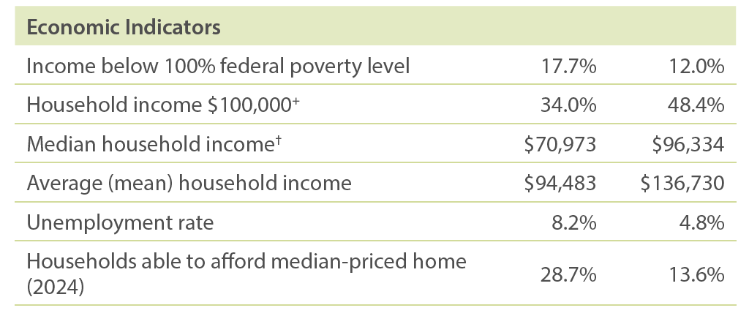
Market Background: San Joaquin Valley
The San Joaquin Valley:
Home to 1.8 million people
Mostly rural, with several dense population centers
Greater population growth than statewide
Compared to California overall:
Higher rate of poverty
Almost twice the unemployment rate
A higher % can afford a median-priced home than statewide — but still only about one-quarter of households
2023 unless otherwise noted
7

Slide 7
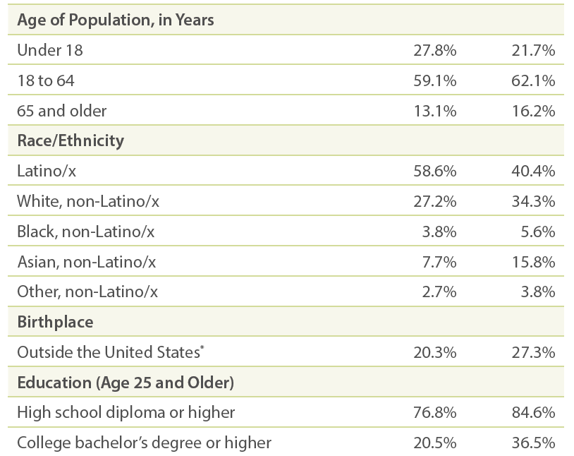
Market Background: San Joaquin Valley
Compared to the state overall, the San Joaquin Valley has:
A younger population
More Latino/x residents
Fewer Asian residents
Fewer high school and college graduates
Lower proportion of foreign-born residents
8

Slide 8
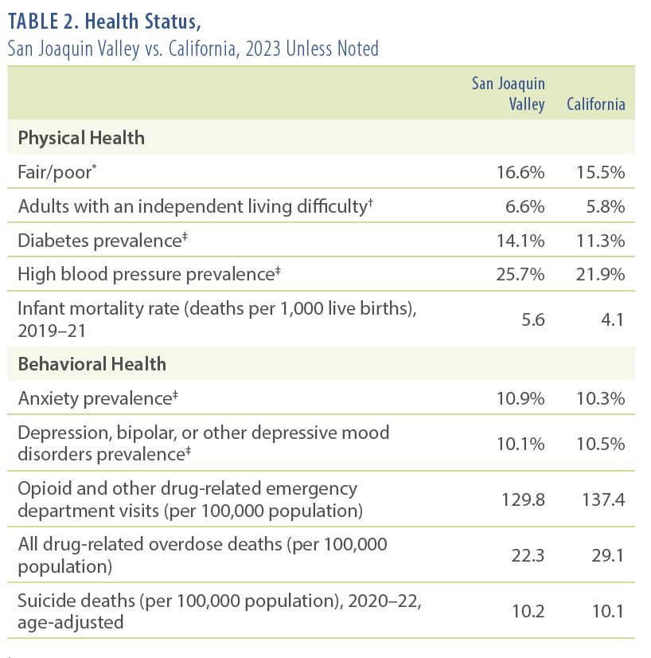
San Joaquin Valley Residents in Poorer Health
Incidence of diabetes and high blood pressure is higher among San Joaquin Valley residents compared to California as a whole.
Compared to the state overall, a larger share of San Joaquin Valley residents self-report fair or poor health status.
The infant mortality rate at 5.6 per 1,000 live births may reflect challenges with maternity care access.
However, SJV residents have lower rates of many behavioral health challenges and outcomes such as depression and drug-related emergency department visits and deaths.
9

Slide 9
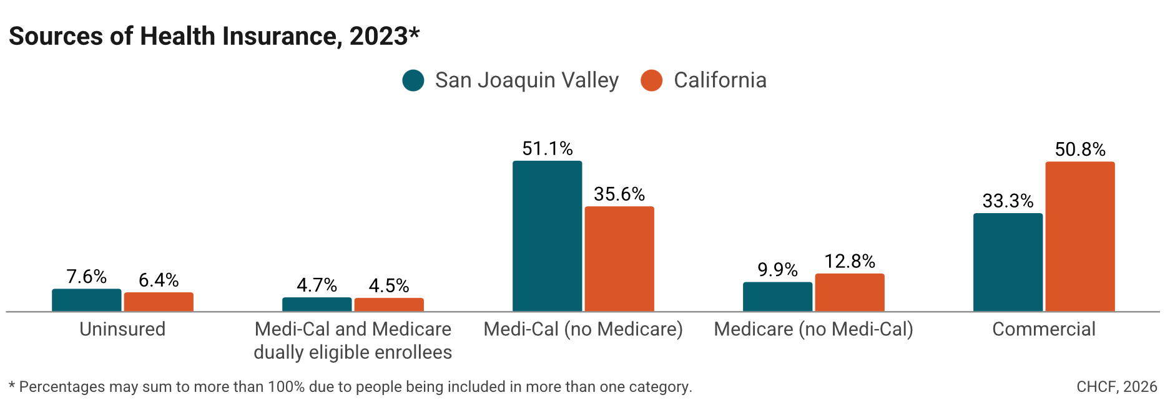
Heavy Reliance on Public Health Insurance
Almost two-thirds of SJV residents rely on public health insurance (Medi-Cal and Medicare).
51.1% covered are by Medi-Cal (62% of Tulare County).
Approximately 80,000 SJV children and adults lacking immigration documentation were enrolled in Medi-Cal by the end of 2024. New enrollments among undocumented adults were frozen in January 2026, with more benefit and enrollment contractions coming later in 2026 and in 2027.
About one-third have commercial insurance, much lower than the 50.8% statewide.

Slide 10
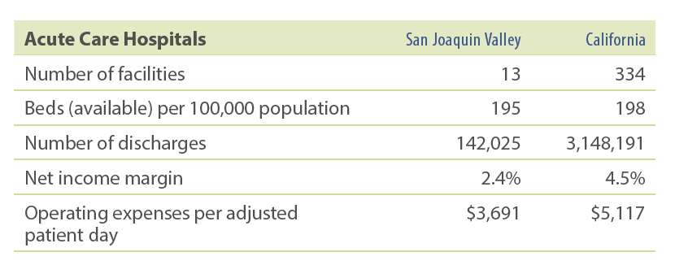
Some SJV Hospitals Report Financial Struggles Coming Out of the COVID-19 Pandemic
Five-county study region served by 13 nonprofit and district hospitals
Three hospitals accounted for nearly 60% of the region’s discharges in 2023:
  Community Regional Medical Center
  Kaweah Delta Medical Center
  St. Agnes Medical Center
Average net income margins vary widely, with the regional average of 2.4% about half of the statewide average
Some SJV hospitals experienced a financial downturn during the COVID-19 pandemic, primarily due to declining inpatient volumes and higher staffing costs
Three hospitals received Distressed Hospital Loans from the state
11

Slide 11
Fall and Rise of Madera Community Hospital
After years of financial challenges, Madera Community Hospital closed in January 2023 and filed for Chapter 11 bankruptcy protection. Three affiliated rural health clinics also closed.
These closures, including elimination of ED and labor & delivery services, increased service volumes at Valley Children’s, Community Regional Medical Center, and St. Agnes Medical Center.
Camarena Health (a Federally Qualified Health Center, or FQHC) filled critical gaps in outpatient care with expanded or new sites in the wake of the Madera closure.
Several hospital systems bid to acquire the Madera Community Hospital, including Adventist+UCSF and St. Agnes / Trinity Health.
American Advanced Management, which reopened Coalinga Regional Medical Center in 2020, won the bid and now manages the hospital.
12

Slide 12
Community Health Centers Continue to Expand in the Five-County Study Region
Community health centers (CHCs), which are mostly FQHCs, provide bedrock access to outpatient care in the SJV region.
CHCs have added more sites and provide more services since the last regional market study in 2020, with more opening soon.
CHCs in SJV serve more patients per capita than CHCs in other study regions and statewide.
77% of CHC revenue comes from Medi-Cal.
United Health Centers, a large regional FQHC, launched a for-profit independent practice association called United Physicians Network.
National hospitalist groups also entered the market since the last regional market study.
13

Slide 13
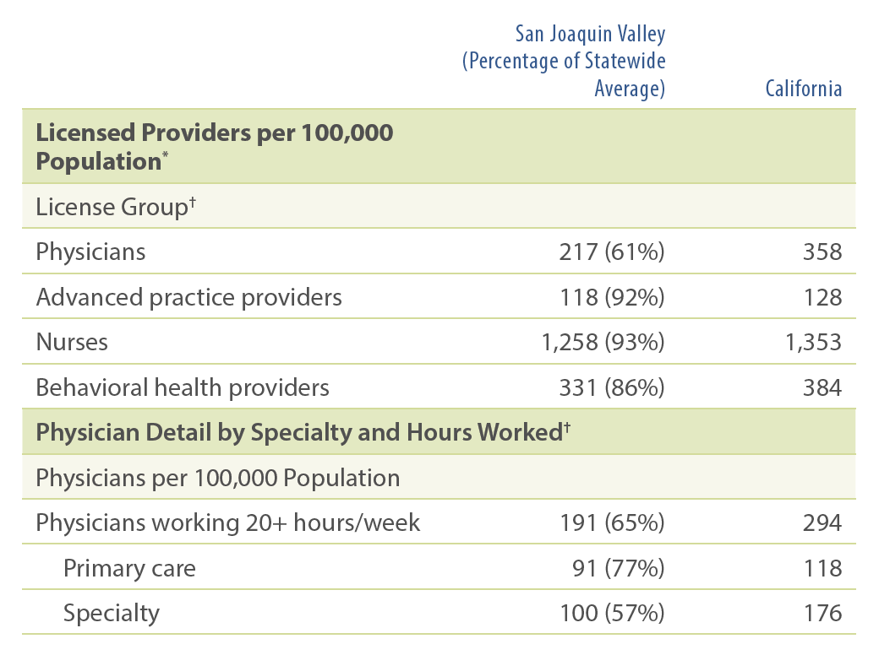
Persistent Workforce Shortages in the Five-County Region
There are fewer licensed providers per population in the study region than in California overall.
The gap is widest for physicians and behavioral health providers.
Across major provider groups, clinician race/ethnicity concordance falls far short of the nearly 60% regional Latino/x population.
14

Slide 14
Study Participants Detail Numerous Regional Strategies to Grow, Recruit, and Retain Workforce
CHCs recruit and retain employees with higher starting salaries and signing and retention bonuses, and facilitate loan repayments with the support of Medi-Cal managed care plan community investment grants.
Most large providers partner with high schools, private technical programs, community colleges, and universities to “grow our own” health care workforce.
Hospitals and CHCs serve as graduate medical education training sites for physicians through accredited residency programs.
Numerous HCAI statewide workforce initiatives support health care workforce pathways (e.g., BH-CONNECT for behavioral health providers).
UCSF Fresno trains 12 third- and fourth-year medical students, residents, and fellows each year.
The PRIME+ program, a collaboration among UCSF, UCSF Fresno, and UC Merced, plans to grow the training cohort to 50 and to include bachelor’s and medical degrees.
15

Slide 15
CalAIM and Behavioral Health Initiatives Welcomed by Regional Leaders, but Implementation Has Been “Exhausting” to Some
Medi-Cal transformation initiatives have brought new benefits and sorely needed behavioral health infrastructure investments.
Managed care plans struggled to build provider networks to deliver Enhanced Care Management and Community Supports services because of the complexity, volume, and back-to-back pace of CalAIM initiative rollouts.
Myriad behavioral health initiatives also rolled out — Children and Youth Behavioral Health Initiative, mobile crisis infrastructure, a “no wrong door” policy, and payment reform.
A major focus has been on members experiencing both serious mental illness and homelessness.
The Behavioral Health Continuum Infrastructure Program has provided some $124 million for new treatment facilities in the region.
16

Slide 16
Looming Federal and State Medi-Cal Cuts: “A Tsunami Is Coming”
Study participants reported widespread anxiety about the coming federal Medicaid budget cuts and policy changes, especially coming on the heels of cuts to balance the 2025–26 state budget.
Providers in the region anticipate an increase in the number of uninsured and reductions in both Medi-Cal benefits and provider payments.
County officials reported interest in revitalizing Medically Indigent Adult Programs as “providers of last resort” to serve the uninsured as the number of uninsured grows.
Many participants were uncertain about CalAIM's future as waivers come up for renewal with CMS.
“Tsunami” of Changes Ahead
Enrollment freeze for undocumented adults (January 2026)
Asset test as part of eligibility determination (January 2026)
Loss of dental benefits for undocumented adults (July 2026)
Changes to immigration status classifications (October 2026)
Work requirements for many Medi-Cal enrollees (January 2027)
Eligibility redetermination every six months (January 2027)
Monthly premiums for some enrollees (July 2027)
17

Slide 17
Issues to Track
Fixed
How will financially struggling hospitals fare through reductions in Medi-Cal payments and an increase in the uninsured and in uncompensated care? Will some hospitals close?
Will independent hospitals join statewide or national hospital systems to shore up financial viability?
Will CHCs continue to expand and further cement their importance to care delivery? How will CHCs adapt to the increase in uninsured and self-pay patients?
Will more outside medical groups enter the market and contribute to a more consolidated physician services market?
18

Slide 18
Issues to Track (continued)
Will providers in the region — hospitals, CHCs, health plans, county public health and behavioral health agencies, and medical groups — increase collaboration to maintain access to care with fewer financial resources?
Will health care provider shortages persist, or will the influx of state workforce investments offer some relief? Will maternity care access advance to a crisis?
How will new CalAIM services and behavioral health investments contribute to long-term structural changes that better serve the region’s most vulnerable Medi-Cal enrollees? How will providers adapt if CalAIM benefits are rolled back?
How will the region’s health status indicators change as residents lose insurance?
19

