Slide 1
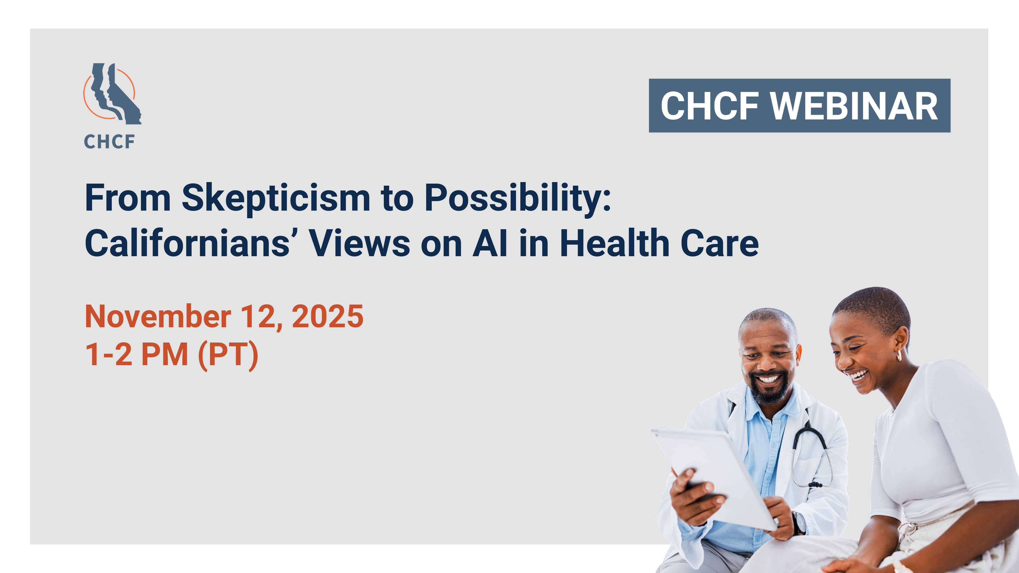

Slide 2



ARTIFICIAL INTELLIGENCE IN HEALTH CARE
Patient Research Study

Slide 3
Key Takeaways
Consumers want to understand how AI is being used
Transparency and control build trust
Patients and their families want human connections to remain central
Cultural and racial context matter for AI adoption
The digital divide affects perceptions of AI
Administrative AI applications receive the most support
3

Slide 4
Awareness + Understanding of ai
DETAILED FINDINGS

Slide 5
General Awareness of AI
Most respondents across groups had some familiarity with AI; either they had heard the term, had seen something about what it is and how it works, or had used it themselves.
Initial exposure to AI often came through work, school, or social media. Most who were familiar with AI had Siri or Alexa at home or had used ChatGPT or other AI tools for school (essays), work (emails, resumes), or personal research.
Awareness was lowest among older adults, respondents with lower incomes, and non-English speakers.
Many noted increased mentions of AI in news, movies, and other entertainment programming over recent years.

Slide 6

Benefits and Drawbacks of AI in General
Respondents across groups expressed the need for balance so the benefits of AI could be enjoyed but the greatest risks could be diminished or avoided.
Valuable source of information (research)
Ability to summarize and synthesize large amounts of data
Can use it to generate content (emails, reports)
Makes common tasks more efficient
Concern over jobs being eliminated
Fear of potential biases based on quality of training/input used
Real-life experiences needed to process information, reason, and make decisions
Could eventually surpass human capabilities and replace them.
Notes:
Risk of unchecked influence and societal impact.; need for caution integrating AI into daily life.

Slide 7
ai in healthcare
DETAILED FINDINGS

Slide 8
Relationship with the Healthcare System
Most respondents were insured, either through Medi-Cal, Covered CA, employer-provided insurance or Medicare. Several lower-income respondents reported going to community clinics for health services.
Healthcare experiences were strongly shaped by personal relationships with doctors. Respondents valued continuity of care and familiarity with their medical history.
Trust in the healthcare system was built on empathetic, attentive providers who were perceived as knowledgeable and up to date.
Distrust stemmed from dismissive doctors, diagnostic delays or errors, lack of transparency in billing/charges, and profit-driven insurers.

Slide 9
Awareness of AI in Healthcare
Some respondents were aware of how AI is currently being used in healthcare, either through personal experience or hearing about it on the news or social media.
AI applications in healthcare some were aware of included automated phone systems and help lines, early cancer detection, medication administration, virtual try-ons for prescription glasses, and robotic surgery.
In terms of actual experience, some respondents had seen laptops and tablets being used at their doctor visits. Several mentioned AI being used to help interpret mammography results.

Slide 10
Perception of AI in Healthcare
Some respondents were optimistic about the ways AI might be able to help improve healthcare outcomes, with more accurate diagnoses, more precise surgeries, or better customer service.
However, the prevailing sentiment was that AI should be used as a tool to help doctors, not to replace the human interaction and experience a doctor represents. Concerns were also raised regarding data privacy and security, a loss of genuine human interaction, and the potential for over-reliance on AI by doctors and other medical professionals.
There was some uncertainty (and apprehension) about whether AI was already being used without their awareness

Slide 11
Cultural Insights Around Healthcare
AANHPI
Hispanic/Latino
African American
Overall distrust of health care system
Older Americans
Prefer language other than English
Respect, dignity, independence
Empathy, connection
Less technologically savvy
Shame, discomfort, fear of misunderstanding
Don’t feel “seen”
Family-centered care
Prefer in-person visits with trusted provider
Experience with not being listened to, dismissed, misdiagnosed or undiagnosed
Need patience, reassurance and clarity
Fear of being “left behind”
11
Notes:
Preferences and concerns on AI largely reflect their experiences in the healthcare system

Slide 12
DETAILED FINDINGS
REACTION TO SCENARIOS

Slide 13
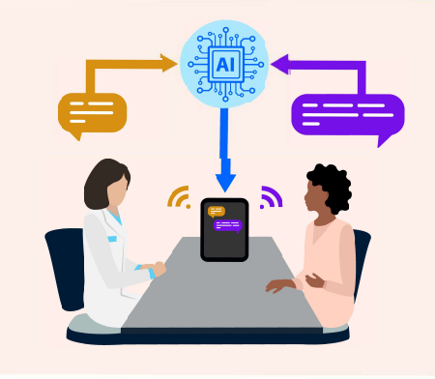
AI in Healthcare Scenarios
Interpretation Services
Scribing
AI-Powered Screenings
AI Front Desk & Triage
Prior Authorization
Predictive Analytics
Notes:
Respondents were presented with a variety of real-life situations depicting current applications and potential future scenarios where AI could be used in a healthcare setting. Despite the visual and a brief explanation, most scenarios had to be explained in detail before the majority of respondents were able to understand. Most wanted to know how the application worked, what the “robot” did and how the doctor was involved. Common reactions across the board were an immediate interest in possible benefits for patients and a strong skepticism/suspicion that these applications might cause patients to be “screwed by the system.”

Slide 14
Positive Reactions
Improved Efficiency
More complete, accurate records
Shorter wait times; increased availability of appointments
Improved Accuracy in Diagnosis + Treatment
Reduce human error
Allow doctors to focus more on patients
Improved Communications
Administrative tools can streamline the complex insurance process
Potential Cost Savings
Translation tools allow patients to speak more freely
Other cost savings (efficiency) could be passed on to patients
Reduced risk of misunderstanding, misdiagnosis

Slide 15
Negative Reactions
Fears over Data Security/Privacy
Concerns over who has access to AI-generated data
Apprehension over continuity of HIPAA protections
Inaccuracy in Diagnosis + Treatment
Uncertainty over reliability, accuracy of AI tools; potential for misdiagnosis, treatment errors
Reduced Communications
Fears of magnified inaccuracy/bias in development, implementation of AI tools
Reduced Quality of Care
Preference for human interaction in health-related situations
Skepticism that any cost savings would only further enrich insurance companies
Fears about data storage and security
Concerns that “robots” could replace actual practitioners (no human oversight)
Risk that doctors could become overly reliant on AI and less engaged with patients
Translation tools can’t capture nuances

Slide 16
Ways to Improve Acceptance
Assurances of human oversight, auditing/review, robust testing and reporting
Implementation of robust data privacy and security measures
Ensuring that patients are informed when AI is being used in their healthcare and given the opportunity to opt in or out.
Involvement of medical professionals in systems, processes aided by AI, including a process for complaints/grievances
Making sure the technology is available to everyone

Slide 17
RECOMMENDATIONS

Slide 18
Patient Education
Patient education is key to introducing AI applications in a healthcare setting. No matter how familiar respondents were with the general concept of AI, they struggled to understand how each application worked in real life, especially how the doctor interacts with the technology and how the patient might benefit from it.
We recommend creating patient education materials such as videos, interactive tools (with Q & A), brochures with graphics/illustrations, emails, etc. featuring AI tools being used in settings familiar to patients.
Include a thorough explanation of how the application works and how it empowers providers rather than replaces them. Point out where in the process the human involvement/oversight occurs and emphasize where the patient can save time or get better results.

Slide 19
Building Trust
Respondents across groups shared a human-centered vision of healthcare — where providers and patients have a strong personal connection and clear interactions.
They tended to embrace the potential of AI most when it was seen as serving practical needs: simplifying administrative work, providing translation, and speeding up insurance hurdles. It is also important to note that the concerns raised were not in opposition to AI itself, but rather about misuse, depersonalization, and lack of transparency.
Communications about AI tools should center on the human benefits: how they support the doctor-patient relationship, help physicians and techs do their jobs better, reduce patient wait times and improve outcomes.
Notes:
Doctors can spend less time typing into computers and more time engaged in dialogue with patients

Slide 20
Informed Consent
These respondents also wanted to be informed (in advance or at the visit) when AI was in use, what data was involved, and what precautions were being taken (by humans) to protect their data. Most wanted to be able to “opt out” of the use of AI in their health care, even as many said they probably would not exercise that option.
While it may not always be practical or applicable to provide informed consent for the use of AI, we do recommend that wherever possible, the explanation of the tool include an “opt out” feature, or at least a paragraph describing a process for doing so.
Similarly, addressing data security, data privacy and oversight practices in the application description/demo will help increase trust in these tools.

Slide 21

thank
you!
MICHELE CORDOBA
michele@cultureiq.group
818-261-8340
ANA FERNÁNDEZ ROCKWELL
ana@cultureiq.group
305-934-9501
THOMAS TSENG
thomas@sengoinsights.com
323-528-0334

Slide 22
Thank you!
Please take the evaluation survey when this webinar concludes. Your feedback is very important to us.

